Slide 1

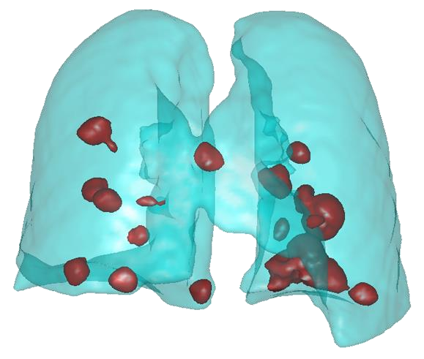
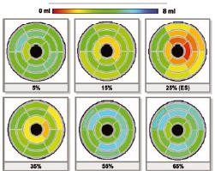
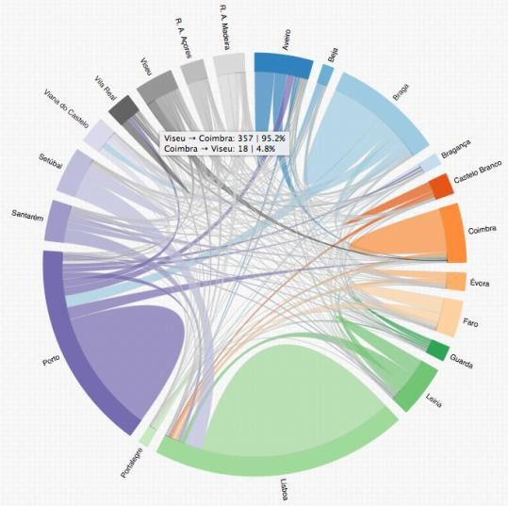
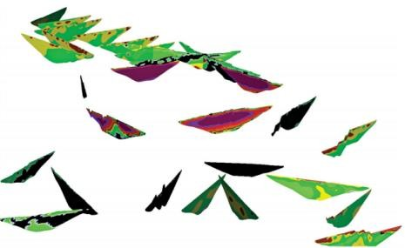
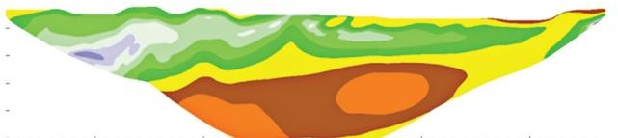
An Introduction to Data and Information Visualization
Universidade de Aveiro Departamento de Electrónica, Telecomunicações e Informática
Beatriz Sousa Santos, University of Aveiro, 2022

Slide 2
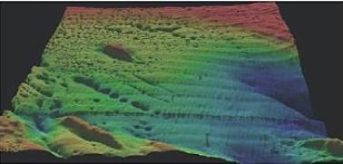
What is Visualization?
Is the process of exploring, transforming and representing data as images to gain insight into phenomena
Passamoquoddy Bay (10⁶ measures)
(Ware 2019)
Portuguese Higher Education (data from 120 000 candidates)
2

Slide 3
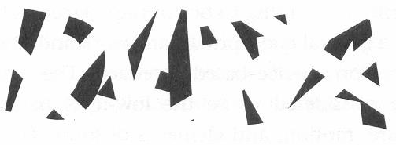



Why and how to represent data visually?
The human visual system is a most powerful pattern seeker
“seeing is understanding…”
We easily see patterns displayed in certain ways
but not in others …
(Ware 2019)
3

Slide 4
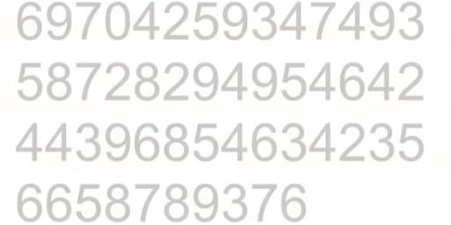
An exercise in preattentive processing: how many “3”?
(Nussbaumer Knaflic, 2015)

Slide 5
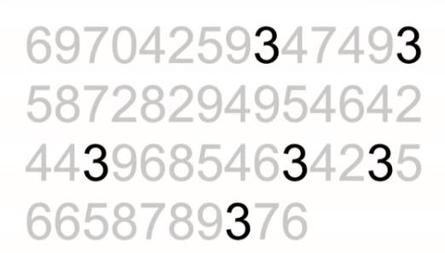
C. Nussbaumer Knaflic, Storytelling with Data ,Talks at Google, 2015 https://www.youtube.com/watch?v=8EMW7io4rSI

Slide 6
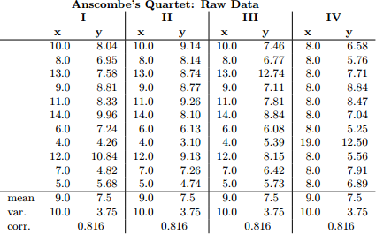
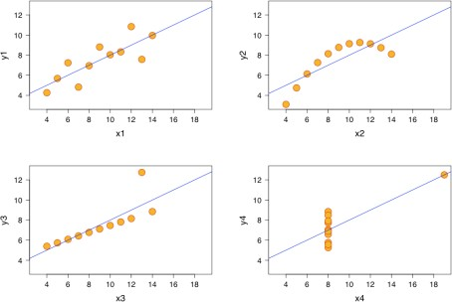
Why show the data in detail?
and not only aggregated parameters
Visualization helps in situations where seeing the dataset structure in detail is
better than seeing only a brief summary of it (loosing information). (Munzner, 2014)
Ascombe quartet: data sets with same
simple statistical properties (Tufte, 1983)
6

Slide 7

Outline of the lectures:
Data and Information Visualization: Introduction
Data Characteristics
Information Visualization:
Main issues
Representations
Presentation
Interaction
Evaluation
Computer graphics:
Interactive graphics systems; Primitives and attributes
Geometric transformations and projections
Visualization pipeline, visibility, illumination and surface rendering, geometric transformations and projections
7

Slide 8
Definition
Objectives History Applications Model
How to obtain and evaluate a Visualization?
8

Slide 9
Definition
Visualization is the process of exploring, transforming and representing data as images (or other sensorial forms) to gain insight into phenomena
There are several expressions used to designate different areas of Visualization:
Scientific Visualization
Data Visualization
Information Visualization
The differences among these areas are not completely clear
Industry uses Data Visualization …
9

Slide 10
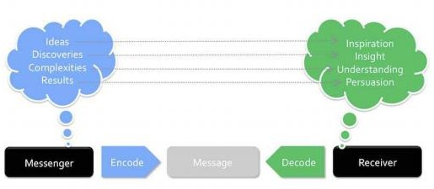
Definition (yet another)
“The representation and presentation of data that exploits our visual perception abilities in order to amplify cognition” (Kirk, 2012)
(Kirk, 2012)
10

Slide 11
Intelligence Amplification as opposed to Artificial Intelligence
(Fred Brooks, 1999)
Visualization may have a significant role in the amplification of human capacities
Several scientific disciplines contribute to Visualization:
Computer Graphics
Human-Computer Interaction
Software Engineering
Image Processing
– Signal Processing
12

Slide 12
Visualization is different from Computer Graphics and Image
Processing since:
it deals mainly with multi-dimensional data ( >= 3D, time varying)
data transformation is fundamental
(may be changed to increase insight)
it is essentially interactive,
(including the user in the process of data creation,
transformation and visualization)
However, there is some overlap:
The output of a visualization process is images
In general uses much CG
13

Slide 13
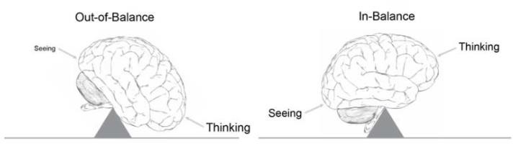
Visualization benefits
Helps us think
Reduces load on working memory
Offloads cognition
Uses the power of human perception
https://www.interaction-design.org/literature/book/the-encyclopedia-of-human- computer-interaction-2nd-ed/data-visualization-for-human-perception
14

Slide 14
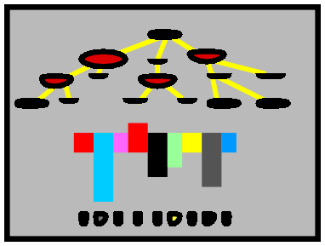

Data
andgain insight
We look at thatpicture
Ah HA ! !
Information visualization
The process of information visualization: graphically encoded data is
viewed in order to form a mental model of that data (Spence, 2007)
15

Slide 15
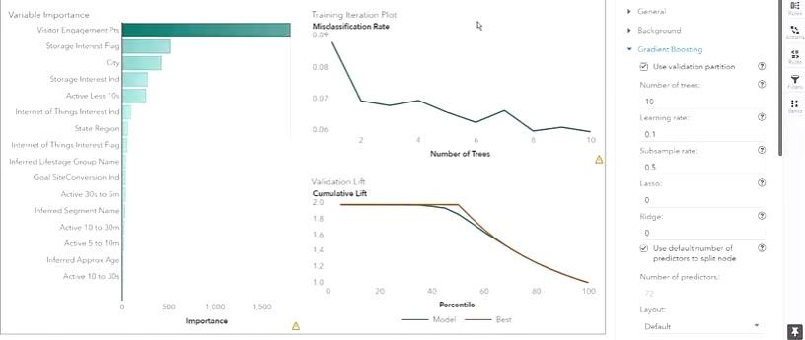
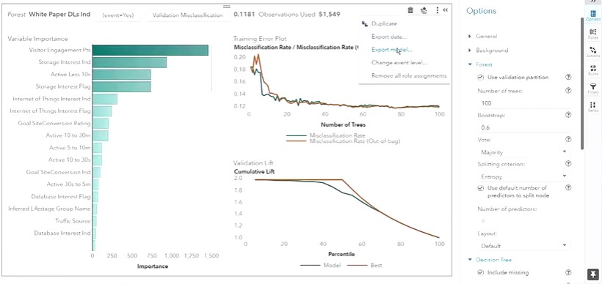
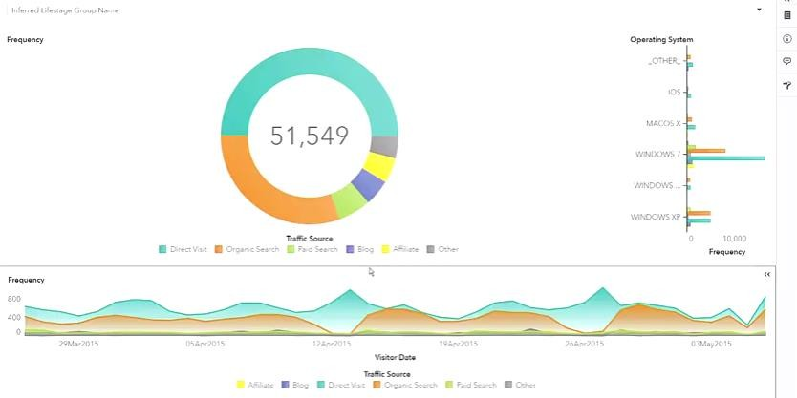
Visualization, Visual Data Mining, and related fields
16

Slide 16
Visualization and Visual Data Mining
Visualization is a field of Computing focused on how to visually explore, transform and represent large amounts of data to gain insight into phenomena
Visual representations take advantage of the human eye’s broad bandwidth pathway into the mind
Visual Data Mining uses visualization in decision support to facilitate data exploration and understanding; it involves
Selecting data,
Transforming,
Representing visually
17

Slide 17
Visualization and Visual Data Mining
Visualization as a scientific field is the process of exploring, transforming and representing data as images (or other sensorial forms) to gain insight into phenomena
Visual data mining techniques are of high value in exploratory data
analysis (Keim, 2002)
Specially when little is known about the data and the exploration
goals are vague
Since the user is directly involved, shifting and adjusting the exploration goals is automatically done if necessary

Slide 18
Main advantages of visual over automatic data mining techniques
(statistics or machine learning):
can easily deal with highly inhomogeneous and noisy data
is intuitive and requires no understanding of complex mathematical or statistical algorithms or parameters.
Visual data exploration techniques provide a much higher degree of confidence in the findings of the exploration.
This makes them indispensable in conjunction with automatic exploration techniques.

Slide 19
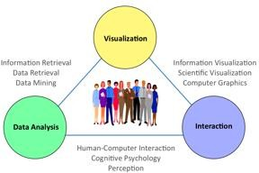
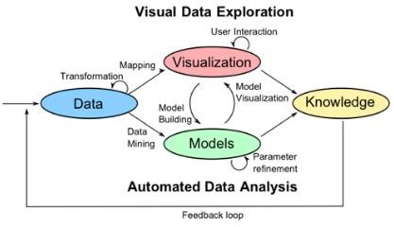
Visual Analytics
The science of analytical reasoning supported by interactive visual interfaces.
“Detect the expected and discover
the unexpected”
Illuminating the Path - The Research and Development Agenda for Visual Analytics
(Thomas and Cook, 2006)
“The Visual Analytics Process combines automatic and visual analysis methods with a tight coupling through human interaction in order to gain knowledge from data.”
http://www.visual-analytics.eu/faq/

Slide 20

Immersive Visual Analytics
(Skarbez et al., 2019) https://www.frontiersin.org/articles/10.3389/frobt.2019.00082/full

Slide 21
Visualization and Machine Learning
Information Visualization and Visual Data Mining leverage the human visual system to provide insight and understanding of unorganized data
Machine Leaning and Visualization share a focus on data and information
The main difference is the role of the user in the data exploration
and modeling:
Machine Learning -> has as ultimate goal to get read of the user
Information Visualization -> allows the user to discover patterns and
adjust models
(Keim et al., 2012)
http://drops.dagstuhl.de/opus/volltexte/2012/3506/pdf/dagrep_v002_i002_p058_s12081.pdf

Slide 22
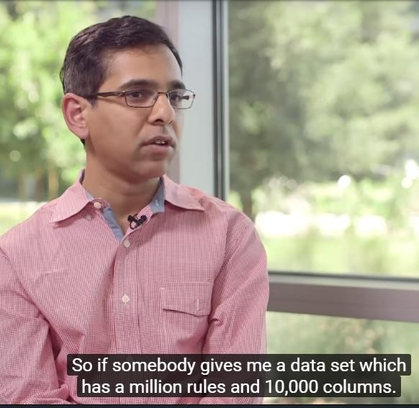
Interviews with Netflix Data Scientists:
How important is Visualization in your job?
One of the most critical aspects of being a data scientist is to visualize what you are actually trying to make sense of
…
it is impossible to build a model unless I understand what the data means
You may do some boxplots,
scatterplots, trend analysis …
Domain scientists play a very important role
https://classroom.udacity.com/courses/ud404/lessons/9239573934/concepts/92387205290923
24

Slide 23
When are Visualization solutions most appropriate?
to analyze data when people don't know exactly what questions they need to ask in advance
for long-term use, where a human intends to stay in the loop indefinitely
(e.g. in scientific discovery, medical diagnosis)
for long-term use to monitor a system, so that people can take action if they
spot unreasonable behavior (e.g. in stock market)
for transitional use where the goal is to “work itself out of a job", by helping the designers of future purely computational solutions, etc.

Slide 24
Visualization in the Data Science Process
Information Visualization may be useful in several stages:
Exploring the data
Selecting the automatic models to use
Monitoring the performance of the models
Detecting when they need to be updated
XAI – Explainable AI:
Explaining the models
recent active trend in AI
Analyzing the results …

Slide 25
Brief history
The usefulness of graphical representations of large amounts of data has been recognized long ago:
XVIII e XIX centuries- use of graphics in statistics and science:
W. Playfair, C. J. Minard
XX century- J. Bertin, E. Tufte
The use of the computer made Visualization a more practicable discipline:
1987 - Identification of Visualization as an autonomous discipline
Visualization in Scientific Computing
(McCormick, de Fanti and Brown – 1987)
27

Slide 26
Brief history
Plenty of Visualization examples of the “pre-computer age”:
Inclination of planetary orbits – Xth century
Import/ export (Playfair) – XVIIIth century
Magnetic declination (Halley) – XVIIIth century
Russia campaign of Napoleon (Minard) –XIXth century
Cholera out-brake in London (Dr. Snow) – XIXth century
28

Slide 27
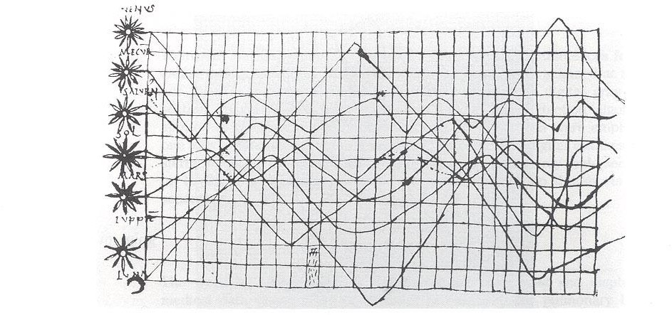
“Pre-computer” Visualization:
One of the oldest known Visualizations
Inclination of orbits along the time - Xth century (Tufte,1983)
29

Slide 28
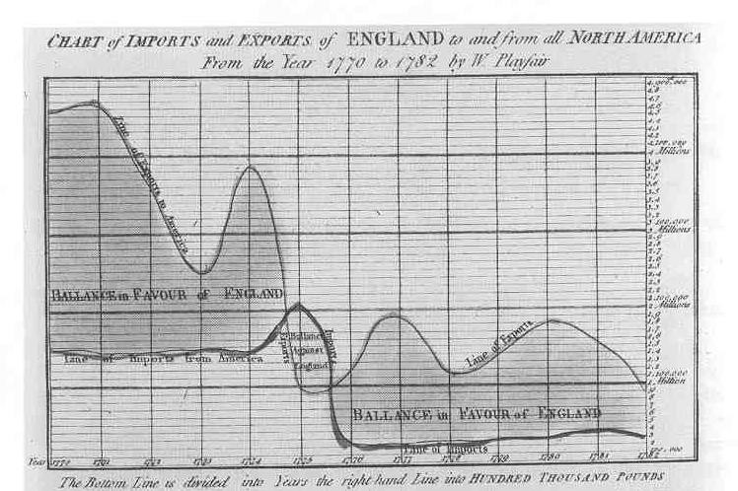
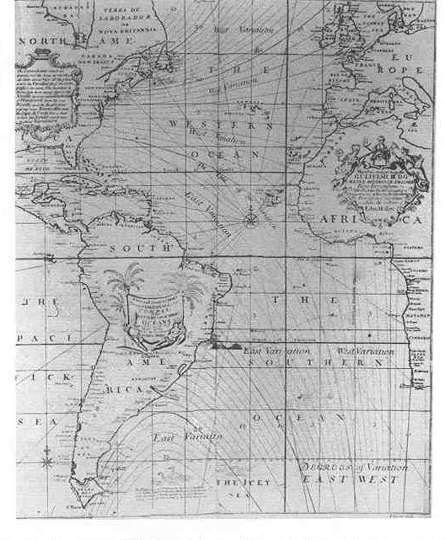
One of the first Visualizations used in “business”
One of the first visualizations using contours (isolines)
Import/export during the period from1770 to1782 by William Playfair (Tufte, 1983)
Magnetic declination 1701 Edmund Halley (Tufte,1983)
30

Slide 29
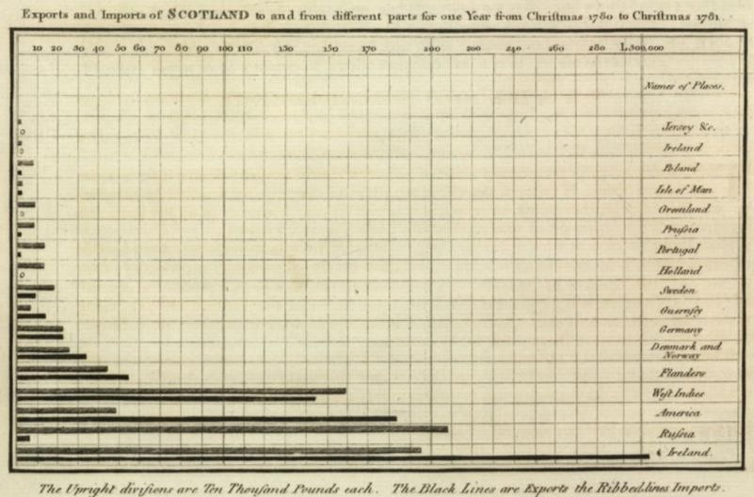
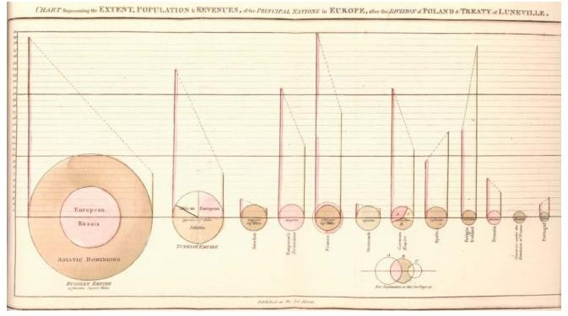
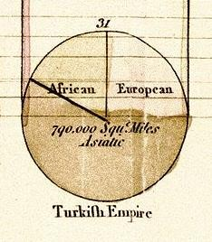
“Ancestors” of simple representations of univariate data
Exports and Imports of Scotland to and
from different parts for one
W. Playfair’s The Commercial and Political Atlas, 1871
https://en.wikipedia.org/wiki/William_Playfair
W. Playfair, Statistical Breviary, 1801
31

Slide 30
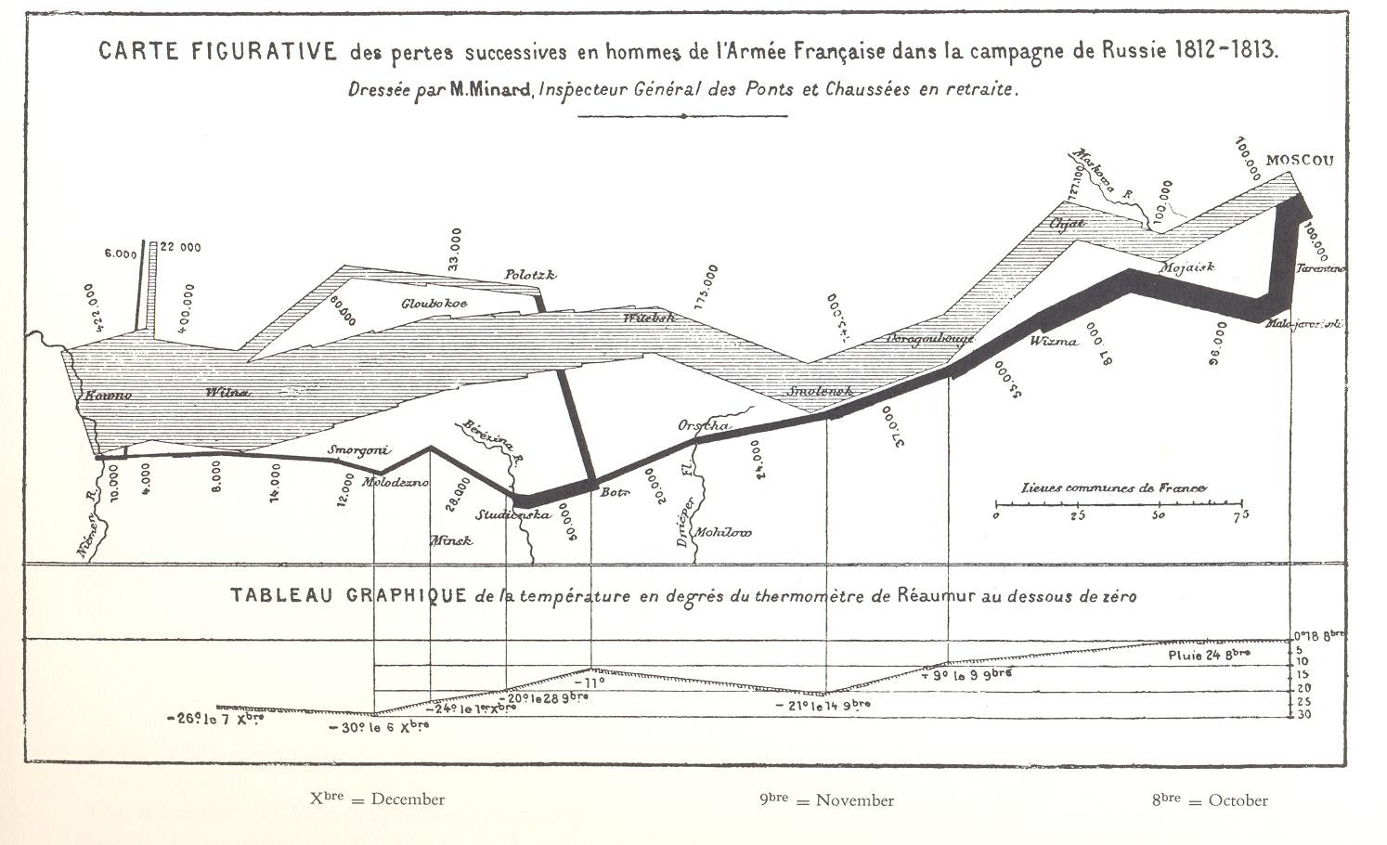
Multidimensional Visualization
6 dimensions: place (2), n. of men and direction of the army, date, temperature
Russia campaign of Napoleon 1861 by Charles Minard (Tufte,1983)
32

Slide 31
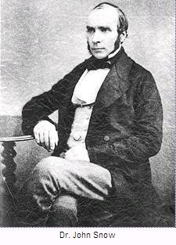
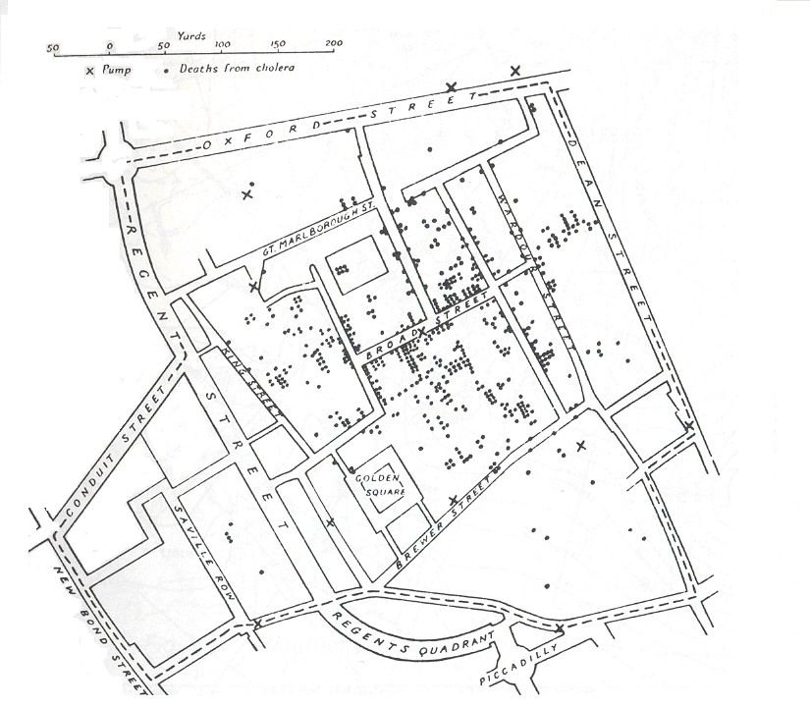
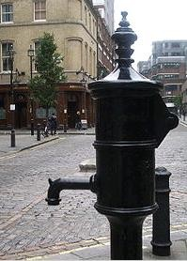
Visualization in scientific discovery
Discovering the cause of the London cholera out brake, 1853-54 (Wikipedia)
33

Slide 32
Data and Information Visualization
In general:
Data (scientific) Visualization (DV) - Data having an inherent spatial structure
(e.g., CAT, MR, geophysical, meteorological, fluid dynamics data)
Information Visualization (IV) – “Abstract” data not having an inherent spatial structure (tabular data)
(e.g., stock exchange , S/W, Web usage patterns, text)
These designations may be misleading; both DV and IV start with (raw) data and allow to extract information
Borders between these areas are not well defined …
34

Slide 33
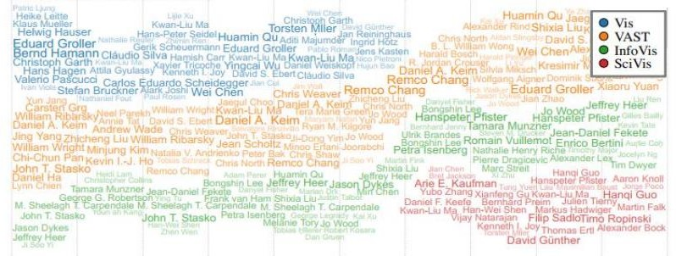
IEEE Visualization: evolution of names in a major conference ….
Vis -> SciVis ~2015
T. Dang , H.N. Nguyen, and V. Pham, WordStream: Interactive Visualization for Topic Evolution
EUROVIS 2019
35

Slide 34
Applications of Scientific Visualization
Scientific Visualization is currently used in many scientific areas:
Medicine
Meteorology, climatology, oceanography
Fluid dynamics
Cosmology
etc., etc.
Let us see some examples …
Can you think of an area where data visualization cannot be applied?
36

Slide 35
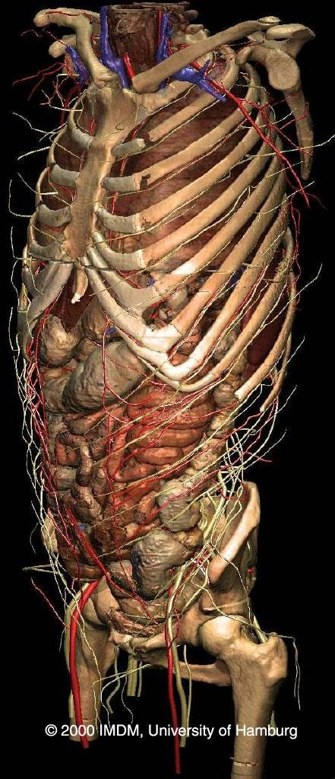
Medicine
(education)
Human anatomy
using volume rendering
VOXELman (University of Hamburg)
Visible Human project (National Library of Medicine-USA)
https://www.visiblebody.com/
http://www.voxel-man.de/3d-navigator/inner_organs/
http://www.nlm.nih.gov/research/visible/visible_human.html
https://www.nlm.nih.gov/research/visible/applications.html
37

Slide 36
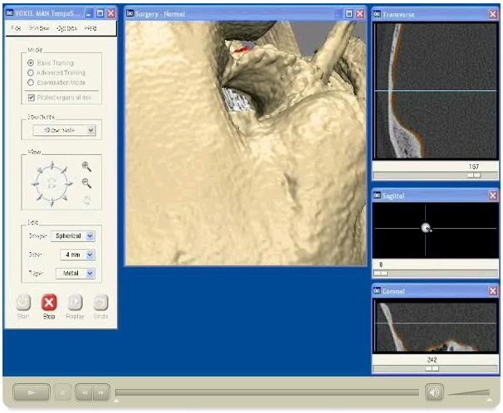
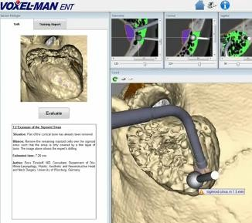
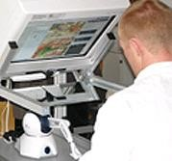
Medicine
(e.g. surgery training)
VOXELman, University of Hamburg
Temporal bone surgery
Movement of the drill is controlled with a force feedback device
https://www.voxel-man.com/simulators/tempo/ https://www.youtube.com/watch?v=CUOm6fxCJqI
38

Slide 37
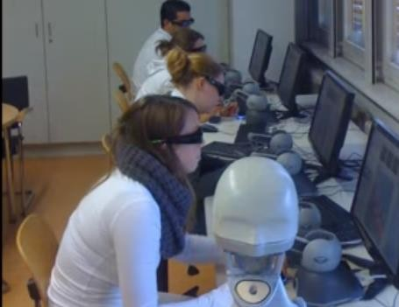
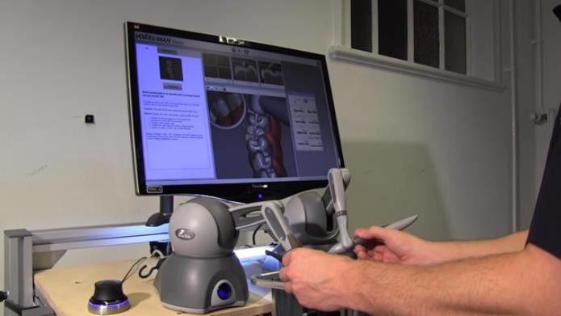
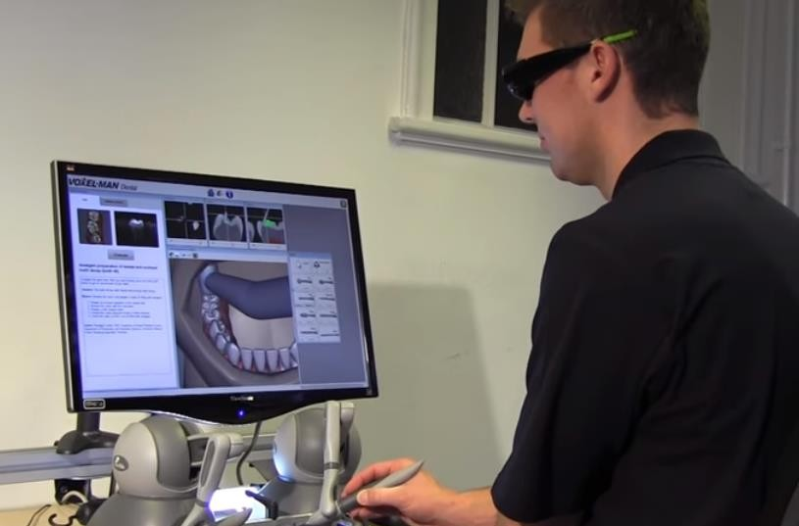
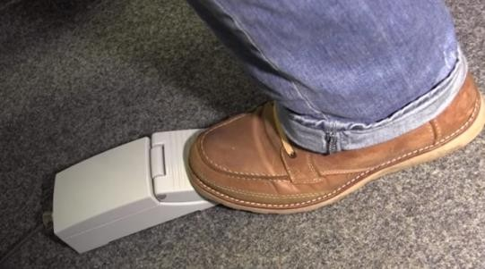
Dentistry
(e.g. training)
Stereoscopic display + glasses
Interaction devices:
two phanton (force feedback)
foot pedal
https://www.voxel-man.com/simulators/dental/
https://www.youtube. com/watch?v=CB_v dW6K42o
39

Slide 38
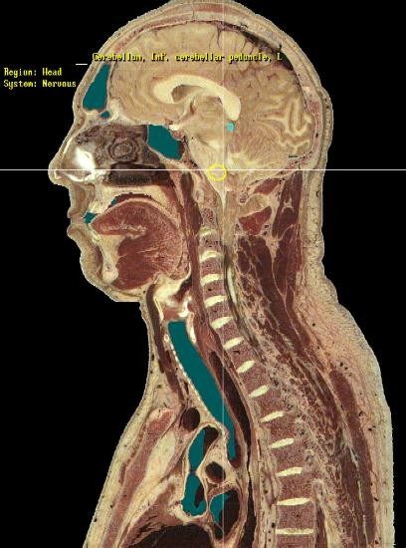
An example of Scientific Visualization: The visible Human Project
(1994,1995)
The data sets were designed to serve as
a reference for the study of human anatomy,
public-domain data for testing medical imaging algorithms,
a test bed and model for the construction of
network-accessible image libraries.
Have been applied to a wide range of educational, diagnostic, treatment planning, virtual reality, artistic, mathematical, and industrial uses.
About 4,000 licensees from 66 countries
As of 2019, a license is no longer required to
access the VHP datasets.
https://www.nlm.nih.gov/research/visible/applications.html
40

Slide 39

Medical Imaging
https://www.mevislab.de/
http://www.nlm.nih.gov/research/visible/visible_human.html
https://www.nlm.nih.gov/research/visible/applications.html
41

Slide 40
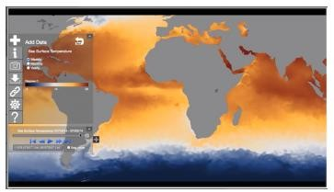
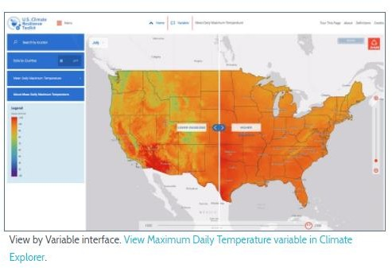
Example in Climate research (by NOAA)
The Climate Explorer offers graphs, maps, and data of observed and projected temperature, precipitation, and related climate variables for every county in the contiguous US
https://www.climate.gov/maps-data/primer/visualizing- climate-data
The tool shows projected conditions
for two possible futures:
one in which humans make a moderate attempt to reduce global emissions of heat-trapping gases,
one in which we go on conducting
business as usual.
https://toolkit.climate.gov/tools/climate-explorer

Slide 41
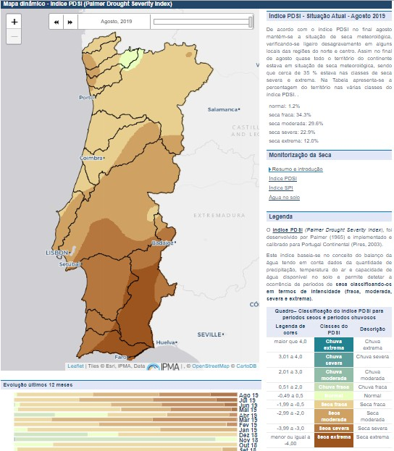
Example in Climate
monitoring:
Drought Severity Index (by IPMA)
http://www.ipma.pt/pt/oclima/observatorio.secas/

Slide 42
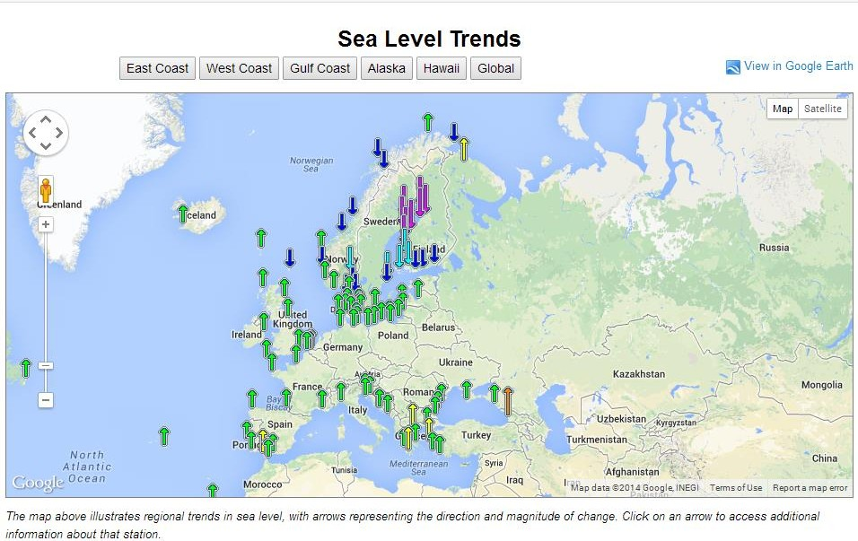
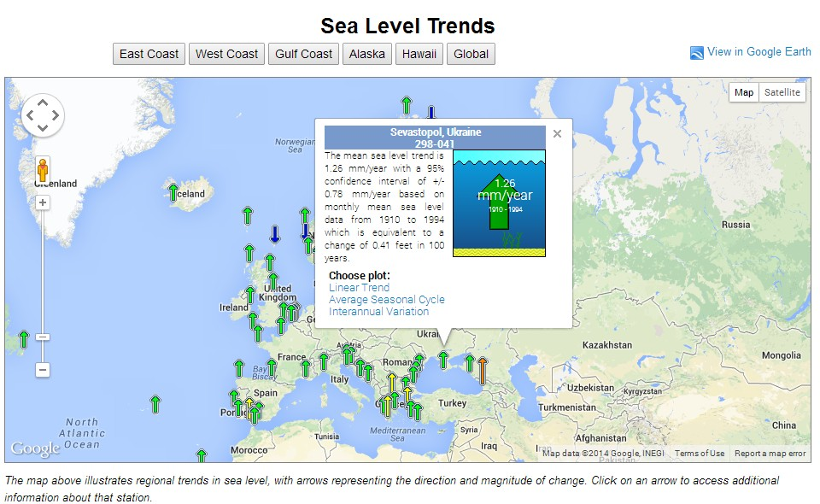
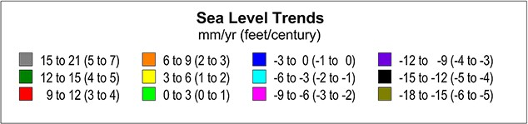
https://tidesandcurrents.noaa.go v/sltrends/regionalcomparison.ht
ml?region=GNEATL
44

Slide 43
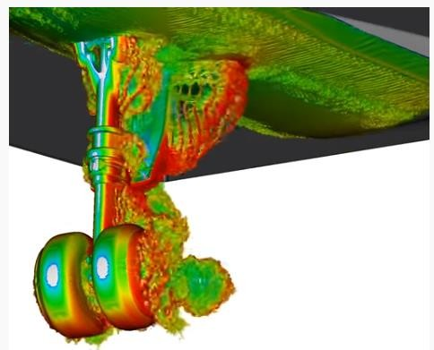
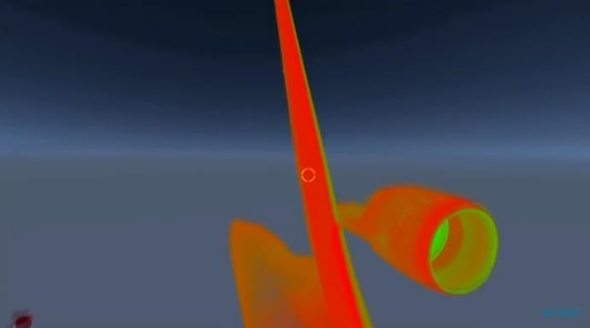
Example of fluid mechanics visualization
NASA/Boeing CFD visualization of vortices responsible for the noise created by the 777's noise landing
https://www.youtube.com/watch?v=F9EFx7aQuhw

Slide 44
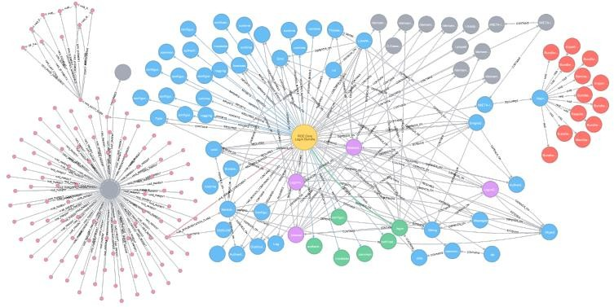
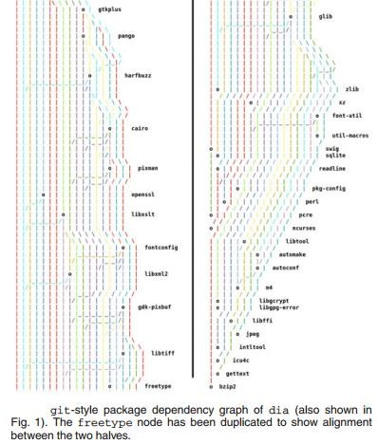

Software visualization
https://ieeexplore.ieee.org/document/8742198
https://ieeexplore.ieee.org/document/8419271
https://ieeexplore.ieee.org/document/9604892

Slide 45


Algorithm visualization
Beyond mathematical and empirical analyses of algorithms
https://visualgo.net/en
https://algorithm-visualizer.org/
47

Slide 46


Machine Learning
visualization
To help understand the “inner workings” of neural networks and other AI methods
https://distill.pub/2020/circuits
/visualizing-weights/
https://ieeexplore.ieee.or
g/document/8807299
48

Slide 47










Scientific Visualization (examples “made in UA”)
Laser scanner (2015)
Ground
Penetrating Radar (1999)
Tomography
(2004)
Tomography
Tomography
(2008)
(2011)
Tomography and SPECT
(1996)
Pollution (2021)
Electrical and mechanical ground resistivity (2010)

Slide 48
Scientific Visualization reference model
Simulated data:
Finite Element Analysis, Numeric methods, ……
Measured data: CAT, MR, ultra-sound laser Digitizers,
Satellites, …..
Data
Transform
Map
Display
Visualization technique
(adapted from Schroeder et al., 2006)
Adequate data pre-processing is vital!
In this course we will not address in detail this phase;
we assume it is tackled in other courses
53

Slide 49




The choice of the right mapping is fundamental, and is particularly difficult in InfoVis
It’s generally easier in Data Visualization, since the data are inherently spatial
Patent landscape (Cheng, 2003) http://www.ipo.gov.uk/informatic- recycleseparate.pdf
Consider terrain altitude data, sea depth
or values of a function:
different mappings or abstract visualization objects can be used,
e.g.
contours (iso-lines)
pseudo-color
three-dimensional surface
56

Slide 50



E.g. medical data visualization, visualizations tend to be “literal” and thus the mapping phase does not vary as much as in other applications
however, there are some possibility of variation
In Visualization of abstract data there is no “natural metaphor”
Making the visual mapping process more difficult
57

Slide 51

Visualization may be used with different purposes:
personal exploration - explorative analysis for
discussion with colleagues - confirmative analysis
presentation to other people
Classical examples for:
exploration
presentation
a)
b)
58

Slide 52


Presentation example: World health
by Hans Rosling: 200 years of health/income – 120 000 values in 4 min
https://www.youtube.com/watch?v=jbkSRLYSojo
60

Slide 53
Whatever the purpose, a visualization:
Should allow offload internal cognition and memory usage to the perceptual system, using carefully designed images as a form of external representations (external memory)
To support users’ tasks
To design simple visualizations or visual data mining applications:
- Need to find what are the questions users will ask!
62

Slide 54
Example: how to select simple charts?
Max and Min temperatures along the month of February (in ºC):
Q1- What were the maximum and minimum values of MaxT? Q2- What was the most frequent MaxT?
Q3- In how many days was that MaxT value attained? Q4- How were the daily temperature ranges?
Q5 – What was the maximum temperature range?
What type of chart would you use to answer Q1?
And the other questions?
day | Max T | Min. T
1 | 15 | 7
2 | 14 | 8
3 | 13 | 6
4 | 13 | 6
5 | 12 | 6
6 | 13 | 7
7 | 13 | 7
8 | 14 | 8
9 | 15 | 5
10 | 12 | 5
11 | 13 | 6
12 | 12 | 7
13 | 11 | 8
14 | 11 | 8
15 | 12 | 8
16 | 12 | 9
17 | 13 | 9
18 | 14 | 9
19 | 14 | 8
20 | 13 | 8
21 | 13 | 8
22 | 12 | 7
23 | 12 | 7
24 | 11 | 7
25 | 11 | 6
26 | 11 | 7
27 | 13 | 6
28 | 14 | 6
63

Slide 55





Example: how to select simple charts?
Temperatures along the month of February (in ºC): a few possible charts
day | Max T | Min. T
1 | 15 | 7
2 | 14 | 8
3 | 13 | 6
4 | 13 | 6
5 | 12 | 6
6 | 13 | 7
7 | 13 | 7
8 | 14 | 8
9 | 15 | 5
10 | 12 | 5
11 | 13 | 6
12 | 12 | 7
13 | 11 | 8
14 | 11 | 8
15 | 12 | 8
16 | 12 | 9
17 | 13 | 9
18 | 14 | 9
19 | 14 | 8
20 | 13 | 8
21 | 13 | 8
22 | 12 | 7
23 | 12 | 7
24 | 11 | 7
25 | 11 | 6
26 | 11 | 7
27 | 13 | 6
28 | 14 | 6
ºC
day
11 12 13 14 15 Max T (ºC)
n. of days
Max T (ºC)
11 ºC
12
13
14
15
64

Slide 56




Simple example
Temperatures along the month of February (in ºC):
Anything “odd” about this chart?
ºC
day
What if the user is color-blind?
Test it using https://www.color-
blindness.com/coblis-color-blindness-simulator/
Max T (ºC)
11 ºC
12
13
14
15
Would you prefer this one?
ºC
day
Do not forget “cultural” aspects, nor individual differences!
65

Slide 57










Information Visualization (examples “made in UA”)
Academic data
Web site usage
(UA, 2004)
(UA, 2020)
Student Migrations
(UA, 2015)
Taxonomy Visualization (UA, 2021)
P
edigree trees (UA, 2011)
www.portugal-migration.info

Slide 58



Information Visualization Reference Model
This course focus on Information Visualization
task
Raw data
Data tables
Visual structures
View
Views
Data Transformation
Visual
Mappings Transformation
Human interaction
Visualization can be described as the mapping of data to visual form
supporting human interaction for visual sense making
(Card et al., 1999)
Visualization is a Human in the loop process! -> which calls for specific
methods
67

Slide 59











In a nut shell:
Do you have a lot of data?
Visualization may be the solution (or at least part of it)
But:
– How to produce a visualization?
What?
Who?
When and where?
How?
– And evaluate it?
We will address these topics in the next lectures
…

Slide 60
Data characteristics
Representations, presentation and interaction
The process of developing a Visualization application
Human characteristics fundamental for Visualization
Evaluation
– Important skills in the profile of “Data Scientist”
70

Slide 61

Example of a usability test of a visual
exploration app
based on a web questionnaire to be answered by a user while observed by an experimenter
https://forms.ua.pt/index.php?r=survey/index&sid=489227
71

Slide 62
InfoVis Books
Spence, R., Information Visualization, An Introduction, Springer, 2014
Munzner, T., Visualization Analysis and Design, A K Peters/CRC Press,
2014
Kirk, A., Data Visualisation: A Handbook for Data Driven Design, 2nd. Ed., Sage, 2019
Spence, R., Information Visualization, Design for Interaction, 2nd ed.,
Prentice Hall, 2007
Mazza, R., Introduction to Information Visualization, Springer, 2009
Ware, C., Information Visualization, Perception to Design, 2nd ed.,Morgan Kaufmann, 2004
Card, S., J. Mackinlay, B. Shneiderman, Readings in Information Visualization: Using Vision to Think, Academic Press, 1999
Bederson, B. , B. Shneiderman, The Craft of Information Visualization: Readings and Reflections, Morgan Kaufmann, 2003
Tufte, E., The Visual Display of Quantitative Information, Graphics Press, 1983
Tufte, E., Envisioning Information, Graphics Press, 1990
Friendly, M., "Milestones in the history of thematic cartography, statistical graphics, and data visualization“, 2008

Slide 63
Data Vis Books
Ward, M. G. Grinstein and D. Keim, Interactive Data Visualization: Foundations, Techniques, and Applications, A K Peters/CRC Press , 2010
Schroeder, W., K. Martin, B. Lorensen, The Visulization Toolkit- An Object
Oriented Approach to 3D Graphics, 4th ed., Prentice Hall, 2006
73

